Slide 1

COAL LAB PROJECT
SNAKE GAME

Slide 2

OBJECTIVE
The idea behind this project is the classic Snake Game. The goal is to control a snake to move and collect food on a map.

Slide 3

TOOLS AND TECHNOLOGIES
The programming language is x86, Assembly Language, and, Operating System is Windows.
LIBRARY
Irvine32.inc

Slide 4
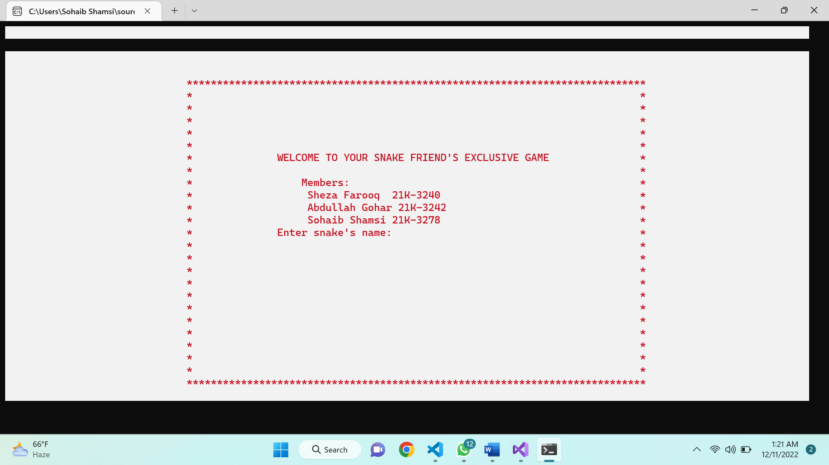
User Enter Name:

Slide 5
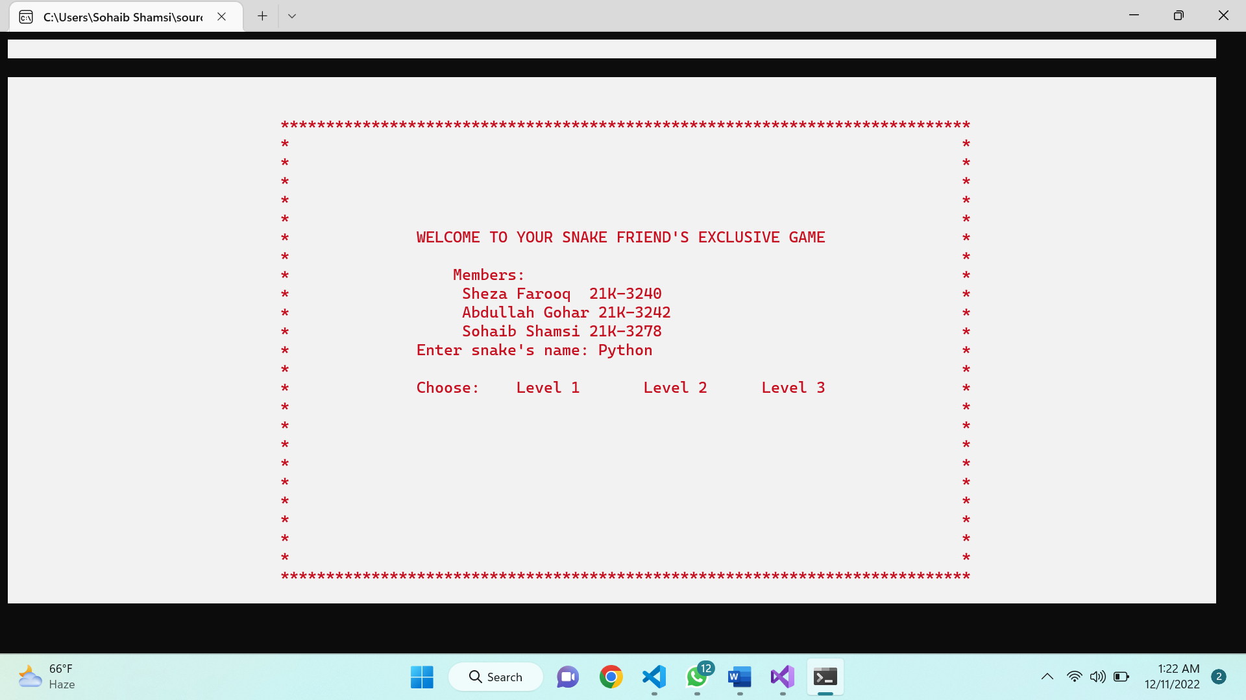
WORKFLOW
Users may choose from 3 different speed levels that are :
1. Level 1: 1*100 speed delay
2. Level 2 : 2*25
3. Level 3 : 3*3 speed delay

Slide 6
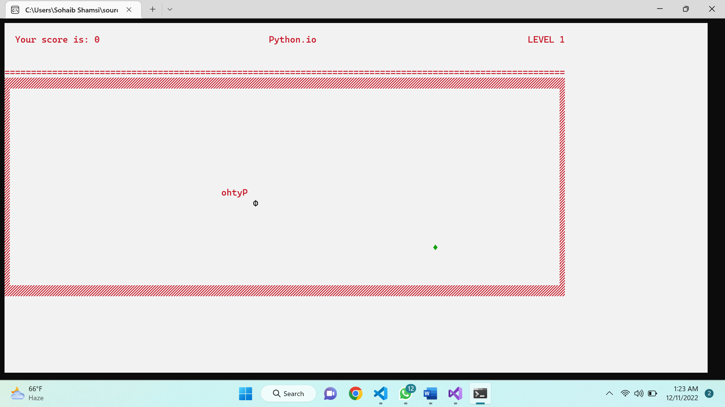
WORKFLOW
food is generated randomly at the start of every game or when the snake eats the previous food.

Slide 7
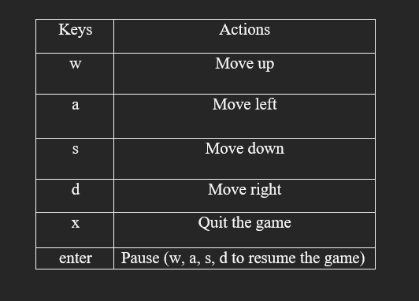
WORKFLOW
The user can move the snake by inputting any of the following keys.

Slide 8
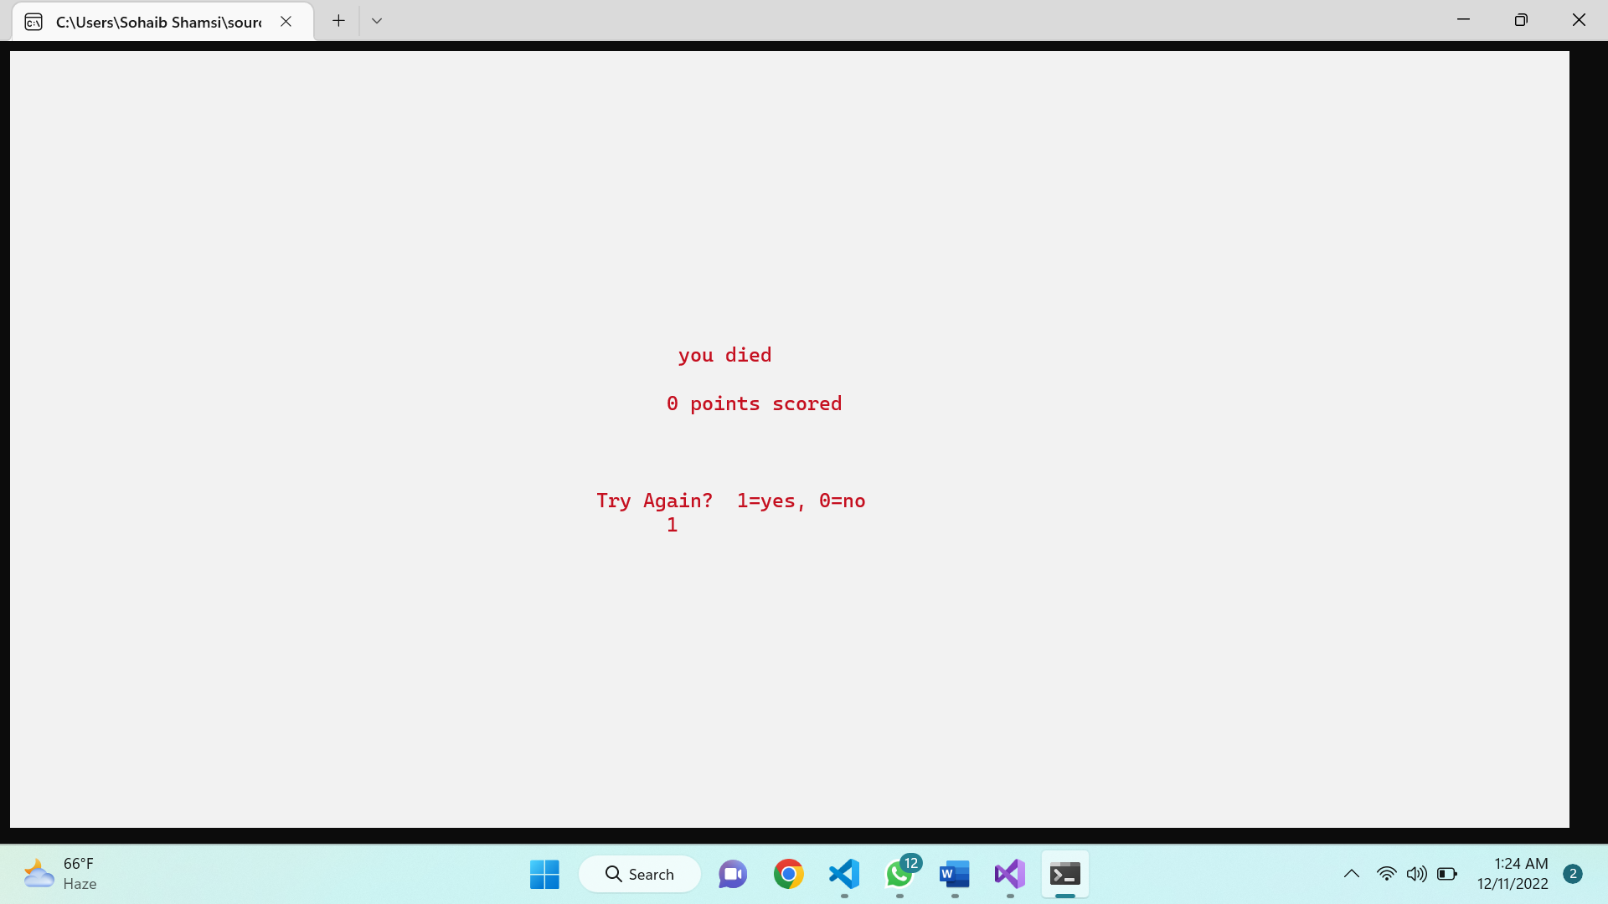
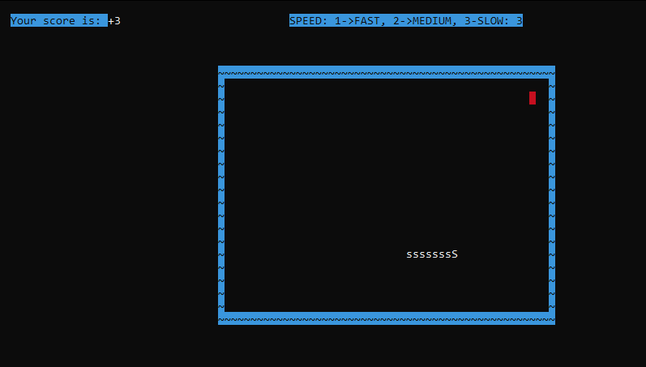
WORKFLOW
The score will be incremented by one whenever the snake eats a coin
A bomb is also generated, when eaten then snake dies!

Slide 9
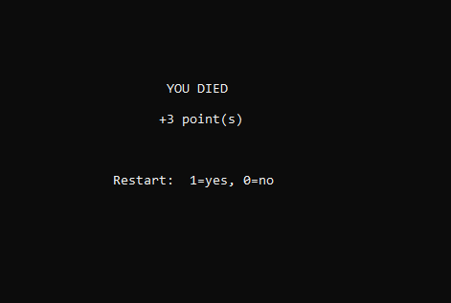
WORKFLOW
. When the game is over, a scoreboard is displayed on the screen to show the user’s current score. The user can also choose to exit or restart the game.

Slide 10
THANK YOU.
Presented By:
K21-3310
K21-4511

